Slide 1

DEMO Design Criteria Overview Planning Meeting 17th January 2017
M. Kalsey

Slide 2
Contents
Introduction
Background
History of DDC
DDC Development
DDC Strategy
M. Kalsey | EDDI Planning Meeting | EuroFusion | 17/1/2017 | Page 2

Slide 3
Introduction
The need for fusion specific structural design criteria is widely accepted as a must have to address specific needs of DEMO.
In response to this need, a package of work was initiated in 2012 by the EFDA Power Plant Physics & Technology (PPPT) organisation: DTM-03 DEMO Design Criteria
Objective:
Provide DEMO specific design criteria for Blankets and Diverters. This design criteria will provide the DEMO designers with a means to assess the structural integrity of all of the concept designs.
This presentation shall present the status of the DDC, past, present and future.
M. Kalsey | EDDI Planning Meeting | EuroFusion | 17/1/2017 | Page 3

Slide 4
Background
Structural Integrity
Codes, Standards and Design Criteria
Codes, Standards and Design Criteria for ITER
Fusion Design Code Development
EDDI
M. Kalsey | EDDI Planning Meeting | EuroFusion | 17/1/2017 | Page 4

Slide 5
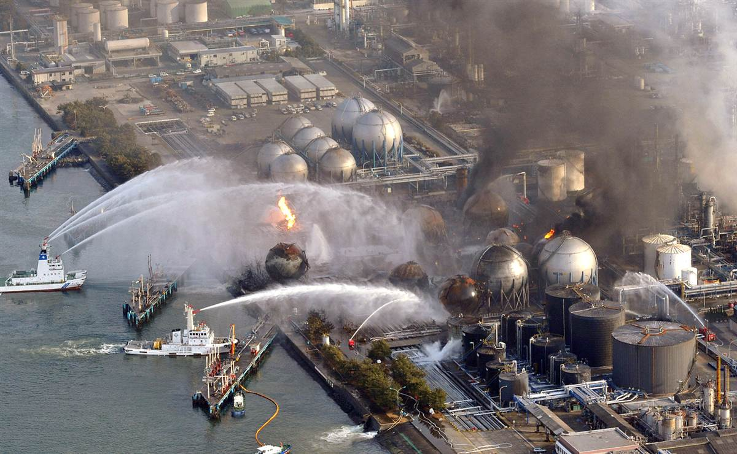
Background – Structural Integrity
Definition of a Structural Integrity
Structural integrity is concerned with designing and operating products that are safe, incorporating a thorough and complete understanding of the loading and the environment they will encounter, underpinned by complete knowledge of the mechanisms by which the materials concerned will fail if their limits are exceeded.
M. Kalsey | EDDI Planning Meeting | EuroFusion | 17/1/2017 | Page 5

Slide 6
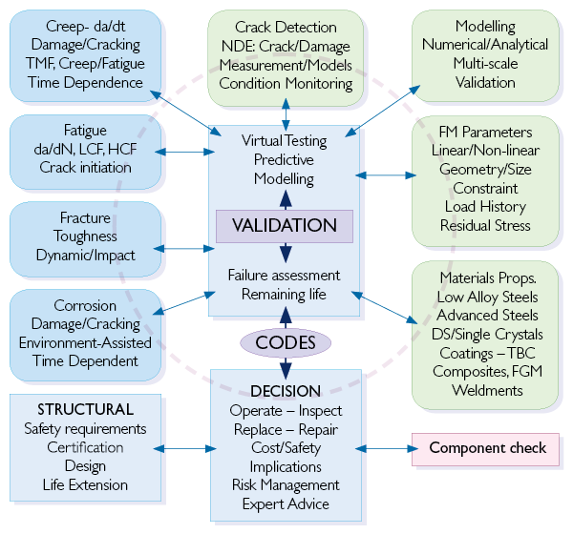
Background – Structural Integrity
Imperial College London
M. Kalsey | EDDI Planning Meeting | EuroFusion | 17/1/2017 | Page 6

Slide 7
Background - Codes, Standards and Design Criteria
Definition of a Standard (ASME)
A standard consists of technical definitions and guidelines that functions as instructions for designers/manufacturers and operators/users of equipment. Standards can run from a few pages to a few hundred pages and are written by professionals who serve on ASME committees. Standards are considered voluntary because they are guidelines and not enforceable by law.
Definition of a Code (ASME)
A code is a standard that has been adopted by one or more governmental bodies and is enforceable by law.
Definition of a Design Critera
A design criteria consists of technical definitions and guidelines that functions as instructions for designers of equipment.
M. Kalsey | EDDI Planning Meeting | EuroFusion | 17/1/2017 | Page 7
Notes:
Purpose of Slide: Define codes, standards and design criteria from outset to ensure all are clear on the language applied for the remainder of the presentation
Example linking regulatory safety requirements (e.g. PED, ESPN) and use of RCC-MRx to facilitate demonstration of compliance with these requirements, with reliance upon the structural design criteria, materials allowables and material specifications within the code

Slide 8
Background - Codes, Standards & Criteria for ITER
There is a multitude of established Fission specific C&S eg. ASME, AFCEN, KTA, JSME…
However, Fusion specific C&S are very limited
Fusion reactors are very different from Fission reactors
ITER needed to adopt a multi-code approach to meet technical and manufacturing requirements
Fusion specific C&S needed
V. Barabash et al. Fus Eng Des 85 1290-1295 (2010)
M. Kalsey | EDDI Planning Meeting | EuroFusion | 17/1/2017 | Page 8
Notes:
Purpose of Slide: Present the approach for ITER

Slide 9
Background - Fusion Design Code Development
2011
2012
2013
2014
2015
2016
2017
DEMO OPTIONEERING
DEMO CONCEPT DESIGN
AFCEN
Modify and extend an existing fission code to cater for fusion's unique in-vessel needs: Evolution of RCC-MRx?
Nuclear Fusion Power-plant
ASME
Create a new fusion specific code: ASME III Division 4
Near Term: Develop DEMO Design Criteria to support DEMO design
EuroFusion
Long Term: tbc
Slide 9
May 2015
M. Kalsey | EDDI Planning Meeting | EuroFusion | 17/1/2017 | Page 9
Notes:
Purpose of Slide: Present the approach for ITER

Slide 10
Background - EDDI
EDDI
Provide DEMO Divertor and Blanket design teams with design validation criteria.
Cover key damage mechanisms
Cover key modifying effects
Cover key joining techniques
Account for Structural and Armour elements
Provide appropriate level of conservatism
Provide clear unambiguous assessment rules
Align with modern FEA packages
Demo Design Criteria
Material Testing (Unirradiated)
Material Testing (Irradiated)
Material Database
M. Kalsey | EDDI Planning Meeting | EuroFusion | 17/1/2017 | Page 10

Slide 11
History of DDC
Summary
Damage Mechanisms
Identification of Gaps
M. Kalsey | EDDI Planning Meeting | EuroFusion | 17/1/2017 | Page 11

Slide 12
History of DDC - Summary
2012 DTM03 – Design Criteria Development.
Identification of DEMO Failure Modes.
Identification of Equivalent Failure Modes in ITER and Gen-IV.
Gaps in existing design codes for the design of DEMO components.
2013 DTM03 – Design Criteria Development.
Design code architecture for DEMO project
The assessment of R5 & R6 Procedures
Creep Fatigue Rules for EUROFER97
Structural Design Criteria for W/W alloys
M. Kalsey | EDDI Planning Meeting | EuroFusion | 17/1/2017 | Page 12
Notes:
Purpose of Slide: Present the approach for ITER

Slide 13
History of DDC - Summary
2014 EDDI 1.3 – DEMO Design Criteria.
Brittle Fracture Rule development
Creep Fatigue Rule development
Creep Fatigue assessment tool
Fatigue Rule development
Joint Rule Gap Analysis
2015 EDDI 1.3 – DEMO Design Criteria.
Brittle Fracture Rule development – continuation
Creep Fatigue Rule development – continuation
Ratcheting Rule development
Creep Fatigue assessment tool – continuation
Fatigue Rule development – continuation
M. Kalsey | EDDI Planning Meeting | EuroFusion | 17/1/2017 | Page 13
Notes:
Purpose of Slide: Present the approach for ITER

Slide 14

History of DDC - Summary
Coordination
DDC Coordination
DDC Development
DDC Industrial Review, Future developments, Classifications
1. Fill Priority Gaps
Brittle Fracture Rule development
Creep Fatigue Rule development
Armour and Joint Design Assessment
2. Improve
Technical Content
Fatigue initiation and crack propagation
Fatigue advanced modeling
Ratcheting rules
Plastic Flow Localisation Rule development
3. Improve use-ability
Creep Fatigue assessment tool
4. Educate the User
Divertor and Blanket Case Studies
Damage Mechanism Physical Examples
DDC Workshops
Slide 14
M. Kalsey | EDDI Planning Meeting | EuroFusion | 17/1/2017 | Page 14

Slide 15
DDC Development
Structure
Damage Mechanisms
Design Life
Design Assessment
Rule Development
Brittle Fracture Overview
Fatigue Overview
Creep Fatigue Overview
Creep Fatigue Tool Overview
Ratcheting
M. Kalsey | EDDI Planning Meeting | EuroFusion | 17/1/2017 | Page 15

Slide 16
DDC Development - Structure
Part 1: General Information: providing required background information, including definitions, load classifications, operating conditions, damage mechanism descriptions and design assessment philosophy.
Part 2: Design Assessment: providing required operating conditions, including definitions, load classifications, operating conditions, damage mechanism descriptions and design assessment philosophy.
Part 3: Material Data: the required physical property data along with the associated design allowable.
Part 4: Example Calculations: design assessment of a DEMO PFC is presented, demonstrating how an assessment should be carried out using ANSYS.
Part 5: Rule Justifications: explanations provided for why new or modified rules are adopted in the DDC.
M. Kalsey | EDDI Planning Meeting | EuroFusion | 17/1/2017 | Page 16
Notes:
Purpose of Slide: Present the approach for ITER

Slide 17
DDC Development - Damage Mechanisms
All Damage Mechanism Descriptions shall contain the same information eg:
5.6 Damage Mechanism
5.6.1 Description of Damage
5.6.2 Affected Materials
5.6.3 Critical Factors
5.6.4 Appearance or Morphology of Damage
Excessive Deformation
Plastic Collapse
Plastic Flow Localisation
Exhaustion of Ductility
Brittle Fracture
Ratcheting
Fatigue
Creep
Creep Fatigue
Swelling
Plasma Erosion
Coolant Erosion
M. Kalsey | EDDI Planning Meeting | EuroFusion | 17/1/2017 | Page 17
Notes:
Purpose of Slide: Present the approach for ITER

Slide 18
DDC Development - Design Life
In structural integrity, 4 main design life targets are often used:
Infinite Life, Component shall never fail.
Safe-Life, Component shall not become damaged during a specified target life.
Damage Tolerant, Component can tolerate a certain amount of damage before deemed to have failed.
Fail Safe, Component failure can be tolerated.
Traditionally the Fusion industry do not go beyond the Safe-Life target.
M. Kalsey | EDDI Planning Meeting | EuroFusion | 17/1/2017 | Page 18
Notes:
Purpose of Slide: Present the approach for ITER

Slide 19
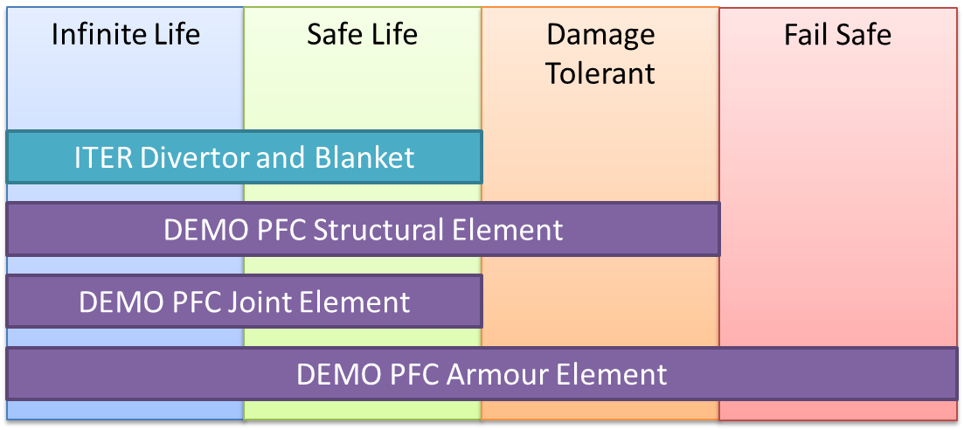
DDC Development - Design Life
The DDC shall, where it is safe to do so, go beyond the Safe-Life target, hence providing an increased design space.
M. Kalsey | EDDI Planning Meeting | EuroFusion | 17/1/2017 | Page 19
Notes:
Purpose of Slide: Present the approach for ITER

Slide 20
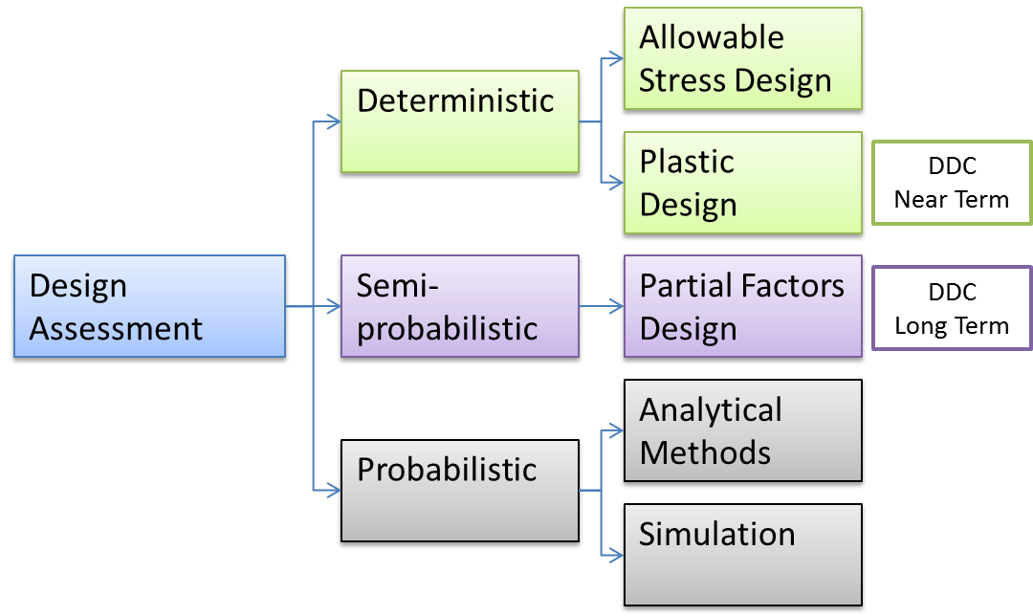
DDC Development - Design Assessment
In the engineering industry, a number of Design Assessment techniques are used in the assessment of safety important components.
The ITER SDC-IC uses both deterministic methods.
In the near term the DDC shall focus on improving the Plastic Design techniques as these are applicable to complex 3D structures (PFC’s).
M. Kalsey | EDDI Planning Meeting | EuroFusion | 17/1/2017 | Page 20
Notes:
Purpose of Slide: Present the approach for ITER

Slide 21
DDC Development – Rule Development
The DDC shall only contain Nonlinear Analysis Design Rules:
This shall remove the need for stress classification, which is not appropriate for complex 3D structures.
There shall be no need for plasticity correction factors.
Shall take advantage of modern computing power, which continues to increase.
Wherever possible, appropriate rules shall be selected from established design codes, however this may not always be possible.
The DDC design rules shall be one of the following:
Replication of an existing rule with full acknowledgment provided.
Re-write of an existing rule, improving the explanation.
Development of an existing rule – Validation and Justification provided.
New rule – Validation and Justification provided.
M. Kalsey | EDDI Planning Meeting | EuroFusion | 17/1/2017 | Page 21
Notes:
Purpose of Slide: Present the approach for ITER

Slide 22
DDC Development – Rule Development
The following damage mechanisms are provisionally defined for all 3 PFC elements. However this is subject to change following a review of Armour and Joint assessment reports.
Damage Mechanisms | Structural Element | Armour Element | Joint Element
Monotonic Damage
Plastic Collapse |  | Potentially relevant | n/a
Plastic Flow Localisation |  | Potentially relevant | n/a
Exhaustion of Ductility |  | Potentially relevant | n/a
Brittle Fracture |  |  | Potentially relevant
Thermal Creep |  | Potentially relevant | n/a
Cyclic Damage
Ratcheting |  | n/a | Potentially relevant
Fatigue
Environmental Damage
Swelling |  | n/a | Potentially relevant
Corrosion |  | n/a | Potentially relevant
Erosion |  |  | Potentially relevant
Compound Damage
Stress Corrosion Cracking |  | n/a | Potentially relevant
Creep Fatigue |  | Potentially relevant | n/a
M. Kalsey | EDDI Planning Meeting | EuroFusion | 17/1/2017 | Page 22

Slide 23
DDC Development – Rule Development
Damage Mechanisms | From existing C&S, rewritten. | From existing C&S, with technical modifications. | Newly developed
Monotonic Damage
Plastic Collapse | ASME VIII rule identified, needs load factors and review.
Plastic Flow Localisation |  | Drafted, Under development
Exhaustion of Ductility |  | Drafted, Under development
Brittle Fracture | Drafted, needs to be reviewed by DME
Thermal Creep | Drafted, needs to be reviewed by DME.
Cyclic Damage
Ratcheting |  |  | Under Development
Fatigue |  | Under Development, needs to be drafted by DME | Under Development
Environmental Damage
Swelling
Corrosion
Erosion
Compound Damage
Stress Corrosion Cracking
Creep Fatigue |  | Under Development, needs to be drafted by DME
M. Kalsey | EDDI Planning Meeting | EuroFusion | 17/1/2017 | Page 23

Slide 24
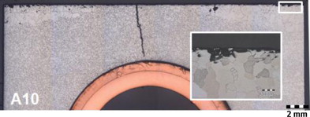
DDC Rule Development - Brittle Fracture Overview
Aim
To increase the design space of Irradiated Tungsten operating below DBTT.
Current Status
Deterministic Brittle fracture design rules from ASME, KTA and EN13445 assessed.
Probabilistic Brittle fracture rules used in ceramic design assessed.
Modified Fracture Mechanical approach (using probabilistic material data) has been proposed to assess the structural integrity of Tungsten components.
Tungsten mechanical test requests raised.
Investigation of numerical simulation of brittle fracture commenced
Who?
Marco Conte & Jarir Aktaa
M. Kalsey | EDDI Planning Meeting | EuroFusion | 17/1/2017 | Page 24
Notes:
Purpose of Slide: Present the approach for ITER

Slide 25
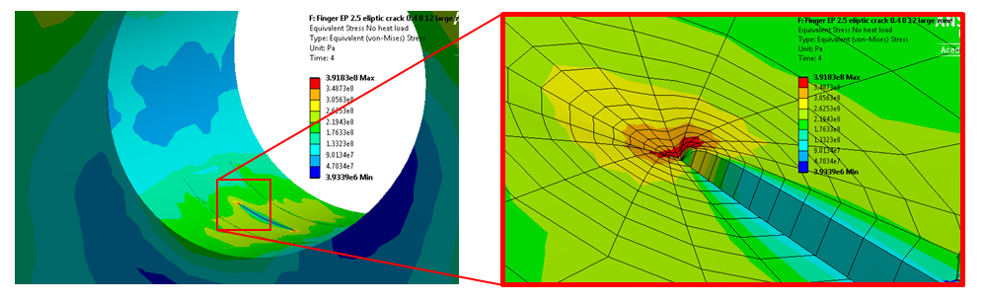
DDC Rule Development - Fatigue Overview
Aim
To increase the available design space by introducing fracture mechanics based crack propagation prediction.
Current Status
Reviewed R5/56, BS7910, FITNET, SDC-IC, RCC-MRx Fatigue rules.
The possibility of splitting the fatigue assessment into, Crack initiation + Crack propagation has been proposed.
Crack initiation prediction techniques has been proposed, this predicts number of cycles to initiation along with initiated crack size.
Fatigue behaviour related to multi-axial stress conditions being investigated.
The effects of residual stress on Fatigue crack initiation and propagation being investigated.
Who?
Mike Fursdon
M. Kalsey | EDDI Planning Meeting | EuroFusion | 17/1/2017 | Page 25
Notes:
Purpose of Slide: Present the approach for ITER

Slide 26
DDC Rule Development - Creep Fatigue Overview
Aim
To develop a Creep Fatigue rules that account for the strain softening effects of Eurofer.
Current Status
Modification of the existing (ASME & AFCEN) creep-fatigue accumulation rules has been proposed.
Development of new creep-fatigue design rules based on advanced damage modelling ongoing.
Creep test requests raised for pre cyclic softened EUROFER specimens.
Data analysis process established, to enable the extension of Creep-data without requiring additional tests.
Who?
Jarir Aktaa
M. Kalsey | EDDI Planning Meeting | EuroFusion | 17/1/2017 | Page 26
Notes:
Purpose of Slide: Present the approach for ITER

Slide 27
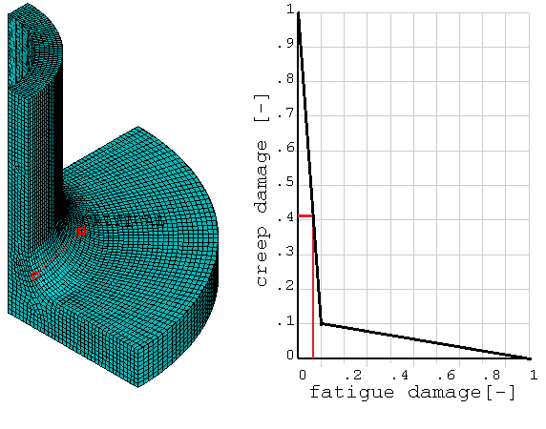
DDC Rule Development - Creep Fatigue Tool
Aim
To develop a Creep Fatigue Assessment tool, that will automate the Creep-Fatigue assessment of PFC’s.
Current Status
Creep-Fatigue assessment tool developed based on ASME-BPVC Sec III Div 1.
Currently the tool works with Elastic Analysis and EUROFER.
CFA tool shall be developed to include the following:
Add parallelization to run the tool on multiple cores
Implement modified creep-fatigue rules for EUROFER
Add additional creep-fatigue data into tool (CuCrZr)
Who?
Michael Mahler
M. Kalsey | EDDI Planning Meeting | EuroFusion | 17/1/2017 | Page 27
Notes:
Purpose of Slide: Present the approach for ITER

Slide 28
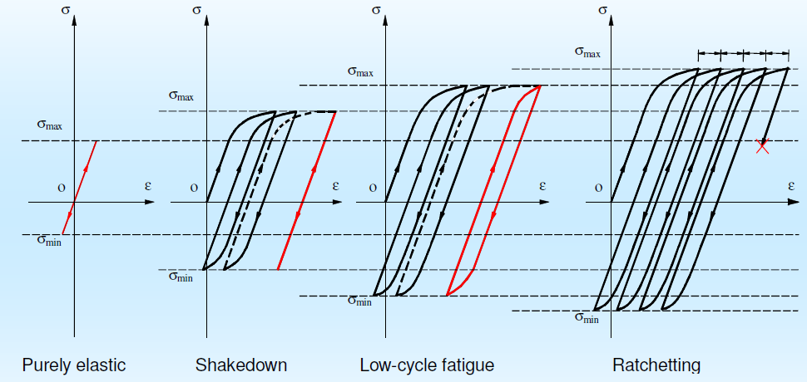
DDC Rule Development - Ratcheting Overview
Aim
To develop the non-linear Ratcheting design rule, improving usability and accommodating both cyclic softening and hardening.
Current Status
Traditional Ratcheting rules assessed (3Sm, Bree Diagram, Efficiency Diagram).
Non-Linear Ratcheting techniques evaluated.
New 2-step Non-Linear Ratcheting technique developed and validated.
The 2-step method maybe extended to include the ability to distinguish between Ratcheting and Low Cycle Fatigue.
Currently developing means to account for cyclic softening and hardening material behaviours.
Who?
James Gardiner
M. Kalsey | EDDI Planning Meeting | EuroFusion | 17/1/2017 | Page 28
Notes:
Purpose of Slide: Present the approach for ITER

Slide 29
DDC Roadmap (Draft)
Requirements extracted from DEMO Roadmap
Nuclear Regulator
Safety Classifications
Strategy
DEMO Project Interaction
Roadmap
M. Kalsey | EDDI Planning Meeting | EuroFusion | 17/1/2017 | Page 29

Slide 30
DDC Requirements
The DDC requirements have been extracted from the DEMO Roadmap & MAT PMP.
Deliver validated and tested design criteria for the BB and DIV teams by June 2023.
Deliver a validated and tested design code for the BB and DIV teams by June 2027.
Engage SDO organisations in the development of the design criteria.
Engage industry in the development of the design criteria.
Provide design rules for components that shall receive a maximum of 30dpa.
Develop DEMO design criteria that is applicable to the baseline materials.
Ensure that the DEMO Design Criteria takes advantage of ITER experience.
M. Kalsey | EDDI Planning Meeting | EuroFusion | 17/1/2017 | Page 30
Notes:
Purpose of Slide: Present the approach for ITER

Slide 31
Nuclear Regulator
Currently site selection for DEMO has not been made, as such potential nuclear regulator interaction can not be fully defined.
However, the following could be determined:
In some European countries new regulations would be enacted to licence a fusion power plant.
New regulation should be targeted and proportionate.
Harmonization of nuclear regulation will eliminate uncertainty about national regulator differences.
Specifically for Fusion C&S:
All relevant laws and regulations must be respected.
Regulator may not impose specific codes and standards.
The operator applying for a license must make their own choices and then demonstrate to the regulator that these are appropriate and will guarantee safety objectives are met.
The regulator will be most concerned with safety related systems.
M. Kalsey | EDDI Planning Meeting | EuroFusion | 17/1/2017 | Page 31
Notes:
Purpose of Slide: Present the approach for ITER

Slide 32
DEMO Safety Classifications
Despite the regulator not dictating required C&S, it is clear that using a Nuclear Code would be beneficial.
Safety Classification | C&S | Note
SIC 1 | Nuclear C&S | Where an appropriate design code does not exist, an agreed surrogate developed specifically for DEMO may be used.
SIC 2 | Standards
SIC 3 | Standards
M. Kalsey | EDDI Planning Meeting | EuroFusion | 17/1/2017 | Page 32
Notes:
Purpose of Slide: Present the approach for ITER

Slide 33
DDC Strategy
Nuclear Codes do not meet the needs of the DEMO Fusion community in a number of key areas:
Insufficient coverage of damage mechanisms in end of life conditions.
Restrictive design space, making it challenging to develop a design solution.
Insufficient irradiated material data.
Insufficient coverage of modifying effects.
Design rules have not been developed for complex 3D structures and modern FEA.
The primary target for the DDC is to:
Develop a new set of design criteria to enable the design of DEMO plasma facing components (Blanket and Divertor) including unprecedented environmental conditions, going beyond and existing framework.
Note: The DDC strategy has been developed assuming that both the BB and DIV shall be SIC1 components.
M. Kalsey | EDDI Planning Meeting | EuroFusion | 17/1/2017 | Page 33
Notes:
Purpose of Slide: Present the approach for ITER

Slide 34
DDC Strategy
Two key milestones have been identified:
Deliver validated and tested design criteria for the BB and DIV teams by June 2023.
Integrate the DEMO design criteria into a Nuclear Code that covers the BB and DIV teams by June 2027.
To achieve this it is proposed that two parallel work packages of work are created:
DEMO Design Criteria Development
Nuclear Fusion Code Development
DDC Coordination, philosophy, documentation and education
AFCEN engagement
Damage mechanism rule development
ASME engagement
Usability and Tools
ISO engagement
M. Kalsey | EDDI Planning Meeting | EuroFusion | 17/1/2017 | Page 34
Notes:
Purpose of Slide: Present the approach for ITER

Slide 35
DDC Strategy
Code Experts
Code Maker
AFCEN, ASME, SDC
Regulator
Industrial
AFW, AREVA?
Project Management
Technical Lead
DIV?
Technical Lead
BB?
DDC Coordinator
M Kalsey
Damage Mechanism
Experts
Plastic Collapse
N/A
Plastic Flow Localisation
tbd
Exhaustion Ductility
tbd
Armour Element
Jeong Ha
Brittle Fracture
Jarir Aktaa
Ratcheting
Mike Fursdon
Fatigue
Mike Fursdon
Creep-Fatigue
Jarir Aktaa
Joint Element
Jason Hess
Material Experts
Design Allowable
?
Material Behaviour
?
EUROFER 97
Ermile Gaganidze
Tungsten
Ermile Gaganidze
CuCrZr
Chris Hardie
M. Kalsey | EDDI Planning Meeting | EuroFusion | 17/1/2017 | Page 35
Notes:
Purpose of Slide: Present the approach for ITER

Slide 36
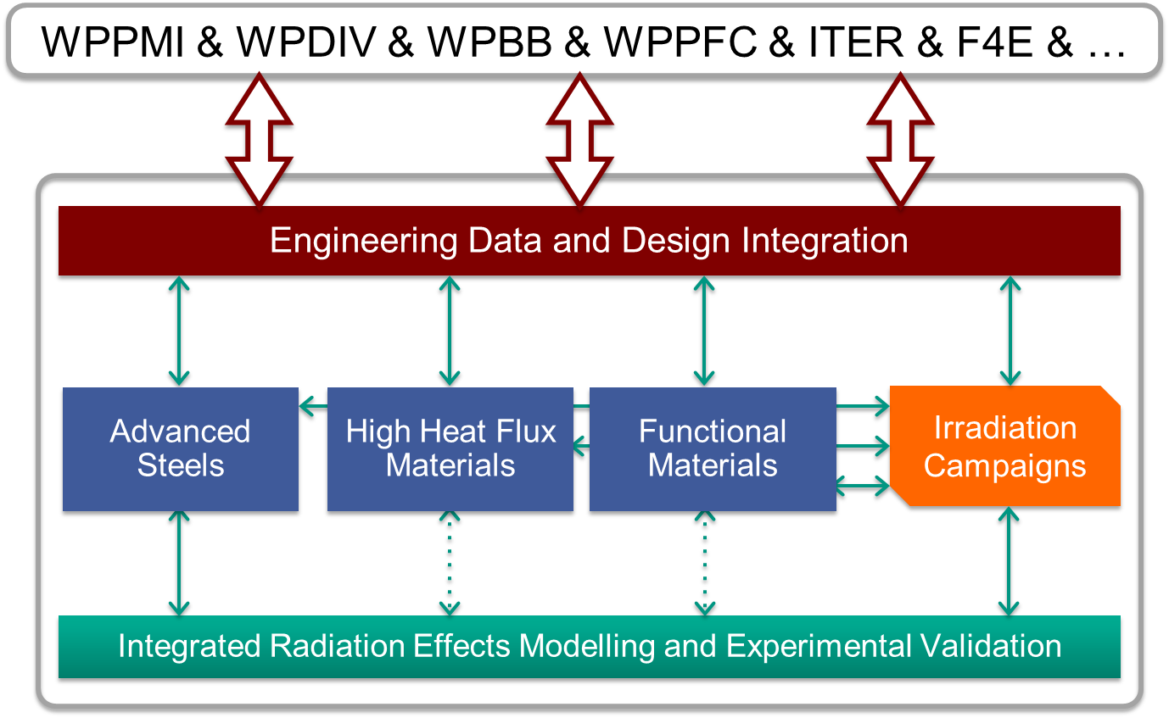
DEMO Project Interaction
To ensure an appropriate level of interaction is maintained the following is proposed:
An EDDI representative must be invited to all BB, DIV & SAE team meetings.
A BB & DIV representative must be invited to all EDDI team meetings.
A BB & DIV representative must be invited to all DDC progress meetings.
The EDDI team shall hold an annual workshop to disseminate progress within the MAT project to the wider DEMO community.
M. Kalsey | EDDI Planning Meeting | EuroFusion | 17/1/2017 | Page 36
Notes:
Purpose of Slide: Present the approach for ITER

Slide 37
DDC Roadmap
M. Kalsey | EDDI Planning Meeting | EuroFusion | 17/1/2017 | Page 37
Notes:
Purpose of Slide: Present the approach for ITER

Slide 38
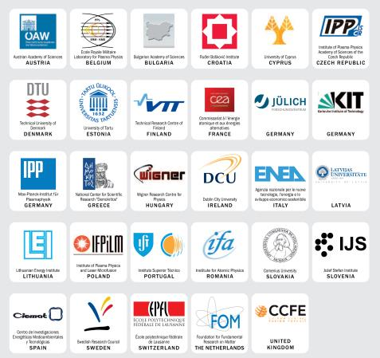
Thank you
M. Kalsey | EDDI Planning Meeting | EuroFusion | 17/1/2017 | Page 38
Notes:
Purpose of Slide: Present the approach for ITER

Slide 39
History of DDC - Identification of Gaps
Damage Mechanisms | ASME-BPVC | RCC-MRx | SDC-IC
Immediate local fracture due to exhaustion of ductility | Not included |  | Development required
Immediate plastic flow localisation | Not included |  | Development required
Ratchetting | Rules exist but not applicable to cyclic softening or non-ductile materials
Creep-fatigue | Rules exist but not applicable to cyclic softening or non-ductile materials
Modifying Effects | ASME-BPVC | RCC-MRx | SDC-IC
Irradiation induced hardening | Not included | Partially covered
Irradiation induced embrittlement | Partially covered
Irradiation induced swelling | Not included | Not included | Not included
Environmental effects (e.g. corrosion, erosion) | Only recommendations for corrosion
Impure helium on fatigue & creep-fatigue | Not included | Not included | Not included
Stress-corrosion cracking | Only recommendations |  | Not included
Notes:
Purpose of Slide: Present the approach for ITER

Slide 40
History of DDC - Identification of Gaps
Materials | ASME-BPVC | RCC-MRx | SDC-IC
CuCrZr, CuAl25 | Not included | Not included | Partially Covered
Eurofer | Not included | Partially covered | Not included
ODS steels | Not included | Not included | Not included
V-Alloys | Not included | Not included | Not included
Zr-Alloys | Not included | Few grades included | Not included
Al-Alloys | Not included | Few grades included | Not included
W & W-alloys | Not included | Not included | Partially covered
W-Cu composites | Not included | Not included | Not included
Notes:
Purpose of Slide: Present the approach for ITER

Slide 41
History of DDC - Identification of Gaps
Joining Techniques | ASME-BPVC | RCC-MRx | SDC-IC
Welding (EB, TIG, laser) | Not examined | Partially covered | Partially covered
Brazing |  | Partially covered | Partially covered
HIP & Diffusion Bonding |  | Partially covered | Not included
Plasma spraying |  | Not included
Active metal casting
Pulsed electric current sintering
High velocity oxyfuel spraying, detonation – D gun
Powder injection moulding
The gap analysis revealed a number of areas that required attention in all of the areas investigated (material data, design rules, joining techniques).
In 2013, the process of filling these identified gaps had commenced.
Note: The tables require updating to reflect changes in existing C&S along with the decision to focus on Elasto-plastic assessment route in the DDC.
Notes:
Purpose of Slide: Present the approach for ITER

Slide 42
History of DDC - Damage Mechanisms
Modifying effects
Immediate plastic collapse
Temperature - Ageing
Irradiation – Hardening, Softening, Loss of Strain Hardening,
Loss of Fracture toughness, Swelling
Environmental – Corrosion, Erosion
Impure Helium – Loss of Fracture Toughness
Immediate plastic instability
Immediate plastic flow localization
Monotonic Damage
Immediate local fracture due to exhaustion of ductility
Brittle fracture
Thermal Creep
Progressive deformation or ratcheting
Cyclic Damage
Fatigue
Combined
Creep - Fatigue
Notes:
Purpose of Slide: Present the approach for ITER

Slide 43
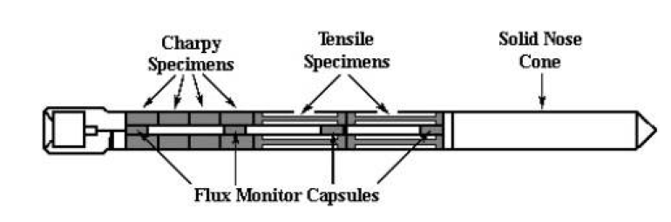
Future Work - Material Data
The challenge of gaining sufficient Irradiated Material data is significant, it is both costly and technically challenging.
It has been recommended that DEMO should explore the option of utilising surveillance techniques in order to evaluate in service conditions.
Develop a list of test specimen geometries.
Propose a surveillance scheme for a EU DEMO reactor.
Consider state of the art testing techniques to support rule development and material database population.
Develop initial designs for what a Fusion specific surveillance scheme could look like.
Notes:
Purpose of Slide: Present the approach for ITER

Slide 44
Future Work - DDC Team
Code Experts
Code Maker
AFCEN, ASME, SDC
Regulator
Industrial
AFW, AREVA?
DEMO
BB, DIV
Coordinator
M Kalsey
Damage Mechanism
Experts
Plastic Collapse
?
Plastic Flow Localisation
Yong Xue
Exhaustion Ductility
?
Armour Element
Jeong Ha
Brittle Fracture
Jarir Aktaa
Ratcheting
James Gardiner
Fatigue
Mike Fursdon
Creep-Fatigue
Jarir Aktaa
Joint Element
Rob Bamber
Material Experts
Design Allowable
Natalia Luzginova
Material Behaviour
Natalia Luzginova
EUROFER 97
Ermile Gaganidze
Tungsten
Ermile Gaganidze
CuCrZr
Chris Hardie
Notes:
Purpose of Slide: Present the approach for ITER

Slide 45
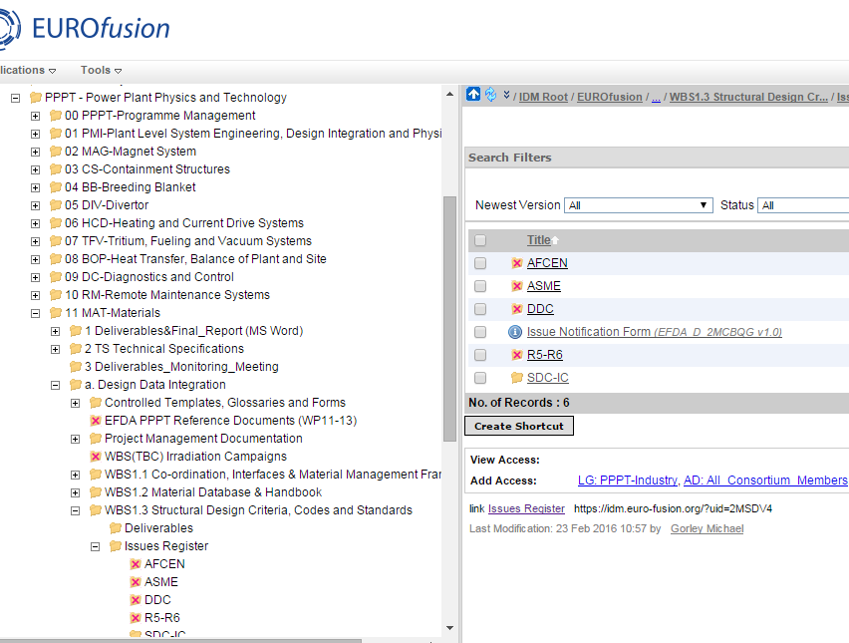
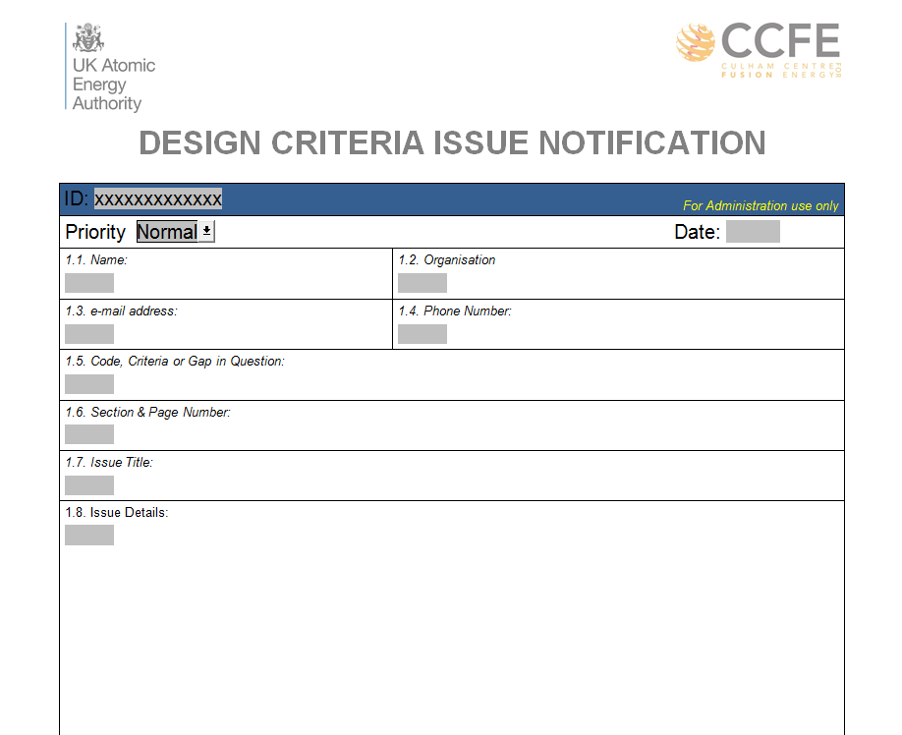
Future Work - DDC Issue Register
DDC Issue Register provides a means for designers to identify key Design Criteria related issues.
Blank form available on IDM.
Once the form is completed it should be uploaded on to the IDM in the appropriate location.
Notes:
Purpose of Slide: Present the approach for ITER

